Slide 1
The Florida Standards: What Every Parent Should Know
Dywayne B. Hinds, Ed.D.
Executive Director,
Middle School Education

Slide 2
Intended Outcomes
Why the Florida Standards?
What are the benefits of the Florida Standards?
Who is impacted?
What is the design of both the FSA ELA & Math Assessments?
When will students in Florida / Pinellas County take the FSA?
Where can you find additional information?
Notes:
It is my intended outcome for our time together this evening to answer these questions --- and that you will walk away with a better understanding of the changes we are experiencing, and the plans that have been put into place to assist your students.
AUDIENCE: How many of you are parents? How many are teachers? How many are administrators?
In a group of this size, it is difficult to address individual questions, and trust me, you will have some! I have provided some blank index cards for you to write a question and leave it with me at the close of our time together. I will collectively answer them and include them in a Q/A compilation that I will send to each principal. They can include the information in their newsletters or post on their website.

Slide 3
Why Florida Standards Matter
Our goal is to ensure Florida’s students graduate high school ready for success in college, career and life. In order to prepare our students for success and make them competitive in the global workplace, we must provide them with a set of clear, consistent and strong academic standards.
The Florida Standards will equip our students with the knowledge and skills they need to be ready for careers and college-level coursework. Having the best and highest academic standards for our students today will prepare them for the jobs of tomorrow.

Slide 4
Benefits of Florida Standards
Preparation:
The Florida Standards will prepare students for both college and the workplace and emphasizes higher-order skills instead of knowledge and recall.

Slide 5
Benefits of Florida Standards
Competition:
The Florida Standards have been influenced by internationally-benchmarked standards, ensuring that our students are prepared to be competitive in the global job market.

Slide 6
Benefits of Florida Standards
Clarity:
The standards are focused, coherent, and clear. Everyone knows what is expected of our students.

Slide 7
Benefits of Florida Standards
Collaboration:
Florida Standards will be a foundation for teachers across districts to work together from the same blueprints. This will facilitate the sharing of best practices.

Slide 8
Who is impacted?
Students in Grades 3-10
Grades 3–10 (and Retake) ELA (Reading component in grades 3–10; Writing component in grades 4–10)
Grades 3–8 Mathematics
Algebra 1* (and Retake)
Geometry*
Algebra 2*
Notes:
All students are being taught the new standards, and the state snapshot of their learning is assessed in grades 3-11.
Students in K-2 are engaged in learning tasks to prepare them for these state assessments, and will have multiple opportunities to practice!

Slide 9
Can you opt out of taking the FSA test?
In accordance with Section 1008.22(3)(b)2., Florida Statutes, “Students enrolled in a course, as specified in the course code directory, with an associated statewide, standardized EOC [End-of-Course] assessment must take the EOC assessment for such course.
State law makes taking part in testing mandatory, so there is no legal way to opt out.
Section 1008.22(3)(b)2., Florida Statutes

Slide 10
Achievement Levels and FSA Scale Scores
Student performance on Florida’s statewide assessments is categorized into five achievement levels. The table below provides information regarding student performance at each achievement level; this information is provided on student reports so that students, parents, and educators may interpret student results in a meaningful way

Slide 11
FSA Scale Scores for Each Achievement Level

Slide 12
Question Formats
Students respond to items in multiple ways. The various question types are designed to assess higher-order thinking skills and offer diverse ways for students to show what they know and can do.
Detailed descriptions of the question formats and item types are available in the item specifications posted to the FSA Portal.

Slide 13
Florida Standards Assessment Format
Paper-based accommodated exams will consist of multiple-choice, multiselect, and gridded-response questions.
Paper-Based Tests
Grades 4–7 ELA Writing
Grades 3 ELA Reading
Grades 5 & 8 Science
Computer-based exams will consist of multiple- choice, multiselect, and technology-enhanced questions (using online tools and manipulatives).
Computer-Based Tests
Grades 8–10 ELA Writing (and Gr 10 Retake)
Grades 4–10 ELA Reading (and Gr 10 Retake)
Grades 3–8 Mathematics
Algebra 1 (and Retake), Geometry, and Algebra 2 EOC assessments

Slide 14
Computer-Based Tools
Back and Next
The Back and Next tools can be used to move to the previous question or the next question.
Save and Pause
The Save button allows you to manually save your work. However, this feature is optional. Your answers will automatically be saved when you move to the next item regardless of whether you select the Save button.
The Pause button allows you to pause and exit the test. If you pause your test, you will have to log back in to the testing system to resume testing.

Slide 15
Computer-Based Tools
End Test
The End Test button will only be available during the last session of your test (Session 2 for Grade 5; Session 3 for Grades 6–8). During earlier sessions, it will be greyed out and you will not be able to select it.
You will only select the End Test button when you are completely finished with your test and ready to submit at the end of your last session.

Slide 16
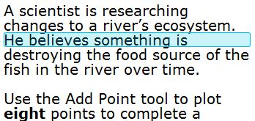
Computer-Based Tools
Line Reader
The Line Reader tool allows you to highlight a specific line in the question.
Zoom Out and Zoom In
Use the Zoom Out and Zoom In buttons to decrease and increase the size of text within the test page.
Four levels of magnification are available.

Slide 17
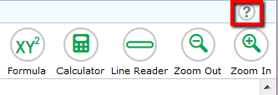
Computer-Based Tools
Help Tool
The Help tool opens a pop-up window with the Help Guide, which includes an Overview of the Test Site, Test Rules, and Accessing Context Menu Tools.
These instructions, which you will also see before logging into the test, remind you how to navigate from one item to the next and how to use the tools and features in the testing platform.

Slide 18
Computer-Based Tools
Strikethrough
You can use the strikethrough tool on multiple-choice and multiselect items to cross out options you think are incorrect.
Right-click or tap the option and choose “Strikethrough.”
Then choose the correct response to the item.

Slide 19
Computer-Based Tools
Highlighter
You can highlight sections of the items.
First, click or tap at the beginning of the section you would like to highlight. Then, drag to the end of the section you want to highlight.
Right-click or tap the selected section and choose “Highlight Selection.”

Slide 20
Florida Standards Assessment Test Design English Language Arts/Literacy Text-based Writing
Notes:
Students will read a stimulus about a single topic. A stimulus consists of several texts written on a single topic. The stimulus should consist of information or literary fiction or nonfiction from 2-4 texts and can cover a wide array of topics. After reading the stimulus, the students will respond to a writing prompt in which they will be required to synthesize provide information on a topic or take a stance to support an opinion or argument citing specific evidence from the texts to support their ideas.

Slide 21
Shifts in English Language Arts
PK – 5: Balancing Informational Text and Literature
6-12: Building Knowledge in the Disciplines
Staircase of Complexity
Text-based Answers
Writing from Multiple Sources
Academic Vocabulary
Notes:
50/50 informational (non-fiction) 50% literature (fiction)
Academic vocabulary: (Isabel Beck’s vocabulary research)
Tier 1 – everyday speech, usually learned in the early grades
Tier 2 – academic vocabulary – more likely to appear in written text than in speech – all sorts of texts – SS, information text, technical texts, literary texts – they represent subtle or precise ways to say relatively simple things (like saunter for walk) highly generalizable across many types of text – and across content
Tier 3 – domain/content specific/field of study

Slide 22
FSA ELA Reporting Categories
Grades 6-10
Key Ideas and Details
Students read closely to understand information. They cite textual evidence to support inferences/conclusions.
They analyze development and interaction of central ideas, themes, individuals, events, or ideas. They
summarize key concepts.
Craft and Structure
Students interpret connotative and figurative meanings of words/phrases. They analyze how word choice affects
meaning/ tone and how text structures impact the text. They determine the effects of point of view or purpose.

Slide 23
Grades 6-10
Integration of Knowledge and Ideas
Students integrate and evaluate content presented in diverse media formats. They evaluate arguments for
claims, validity, relevance, and sufficient evidence. They analyze treatment of similar themes or topics.
Language and Editing
Students demonstrate command of the conventions of standard English grammar, usage, capitalization,
punctuation, and spelling.
Text-Based Writing
Students draw relevant evidence from various texts to support a claim or controlling idea. They produce clear
and coherent writing with development, organization, and style appropriate to task, purpose, and audience.

Slide 24
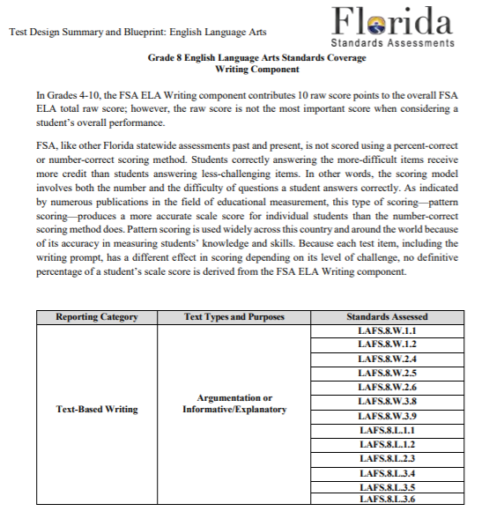
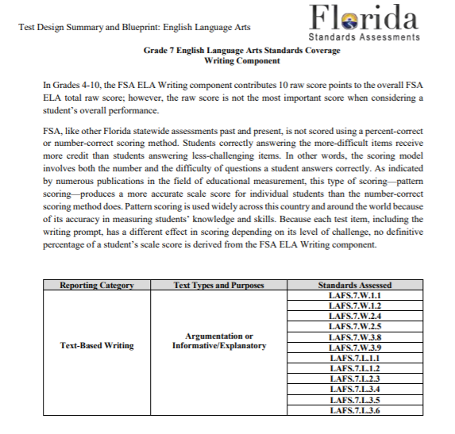
FSA Writing Components
Text-Based Writing
Argumentation or Informative/Explanatory

Slide 25
FSA ELA – Writing Component ONLY
Grade | Number of Items | Number of Sessions | Number of Days | Administration Mode/Test Materials* | TOTAL Testing Time**
6 | 1 prompt | 1 | 1 | PBT | 120 minutes
7 | 1 prompt | 1 | 1 | PBT | 120 minutes
8 | 1 prompt | 1 | 1 | CBT | 120 minutes
*All students (PBT and CBT) receive a planning sheet.

Slide 26
FSA ELA Writing Component
For responding to text-based prompts:
Spell check – NO
Bold
Italics
Underline
Remove formatting
Insert/remove numbered list
Insert/remove bulleted list
Decrease indent
Cut, copy, paste, undo, redo
Insert special character

Slide 27
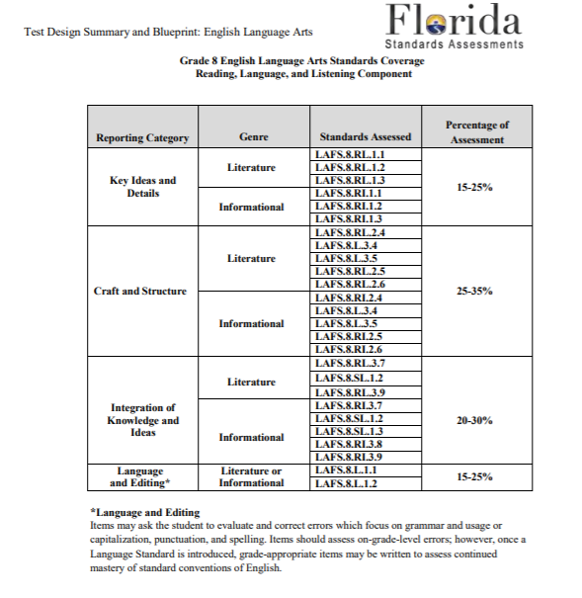
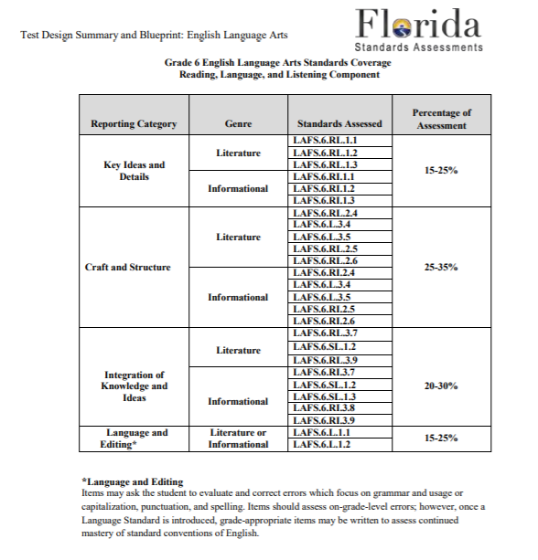
FSA ELA Standards

Slide 28
FSA ELA Reading Component
Grade | Number of Items | Number of Sessions | Number of Days | Administration Mode in 2015/ Test Materials | TOTAL Testing Time
6 | 58–62 | 2 | 2 | CBT with worksheet | 170 minutes
7 | 58–62 | 2 | 2 | CBT with worksheet | 170 minutes
8 | 58–62 | 2 | 2 | CBT with worksheet | 170 minutes
30

Slide 29
Florida Standards Assessment Test Design English Language Arts/Reading
Editing Task Items
Multiple Choice Items
Multi-select Items
Two-part Items
Hot Text Items
Open Response Items
Graphic Response Items (GRID)
Text with a Series of Questions
Text-based Writing
Notes:
Item types that may appear on FSA ELA training tests include:
Editing task items – Students click on a highlighted word or phrase. The editing task requires some editing tasks items that require you select the replacement word or phrase from a menu.
Multiple Choice Items – Requires you to select a single answer option.
Multi-Select Items – Allows you to select more than one answer option. They are different from multiple-choice items which allow you to select only one response. Some items may ask you to select a specific number of responses.
Hot Text Items – A selected amount of text is provided and you will be asked to highlight words, phrases, or sentences to answer a question.
Open Response Items – Requires you to use the keyboard to enter the response into a text field. Different types of open-response items may appear on the test.
Graphic Response Items (GRID) – Requires you to drag a response option from one location on the screen to another.
Evidence-based Selected Response items – Requires you to highlight the evidence in a selected amount of text to support your answer. These types of tasks are found in hot text and multi-select items.

Slide 30
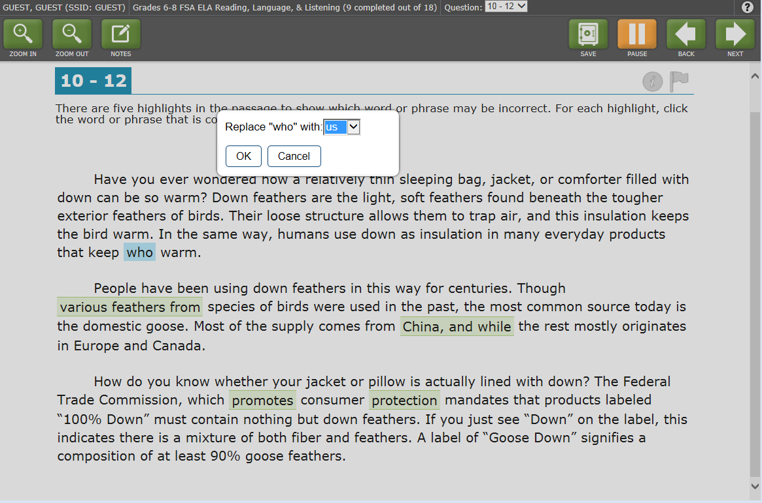
Editing Task Item
Notes:
This item measures students’ understanding of language mechanics asking the students to consider the highlighted word choice and whether it is correct or not. If not, students select the answer they believe to be correct from a drop-down menu of choices.

Slide 31
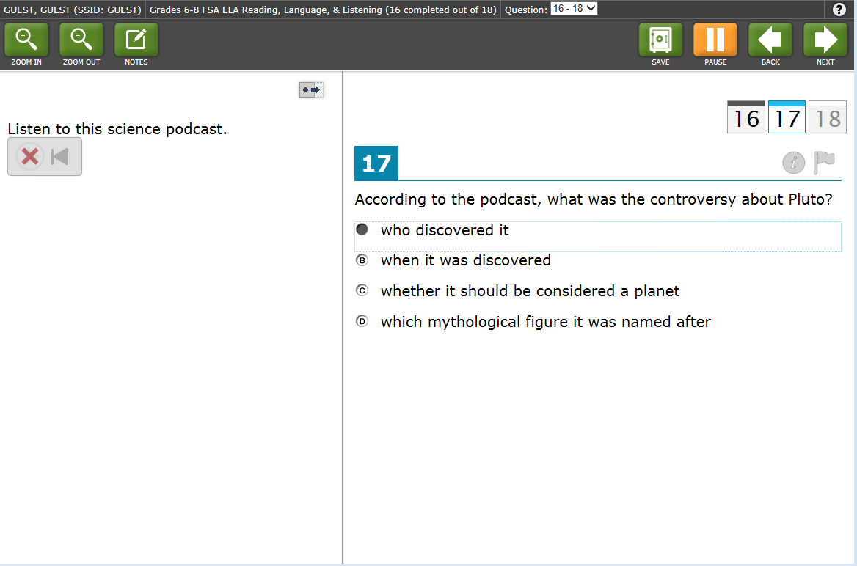
Audio Multiple-Choice Item
Notes:
A new type of item for our students are items that are read to the students without the students having the text in front of them. The students listen to the text being read to them and then select their answers to the questions on the screen after listening. In the provided example, there are three questions. The sample question shown on the slide is a multiple-choice item. The other two questions could be hot text (where students move information around on the screen), multiple-select (where students select more than one answer per question), or open response (where students are asked to write a response).

Slide 32
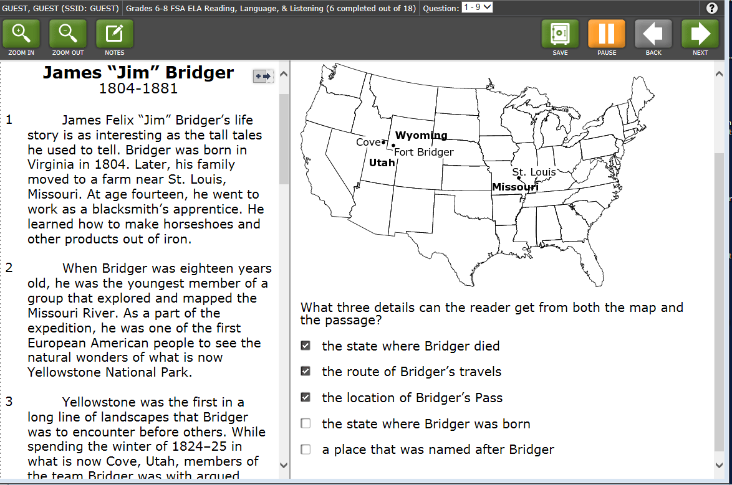
Multi-Select Items
Notes:
In the multi-select items, students are asked to select more than one answer option. In the example on the screen, students are asked to select three of the five details provided. Scoring guidelines have not been provided so we are not sure whether partial credit can be awarded for partially correct responses.

Slide 33
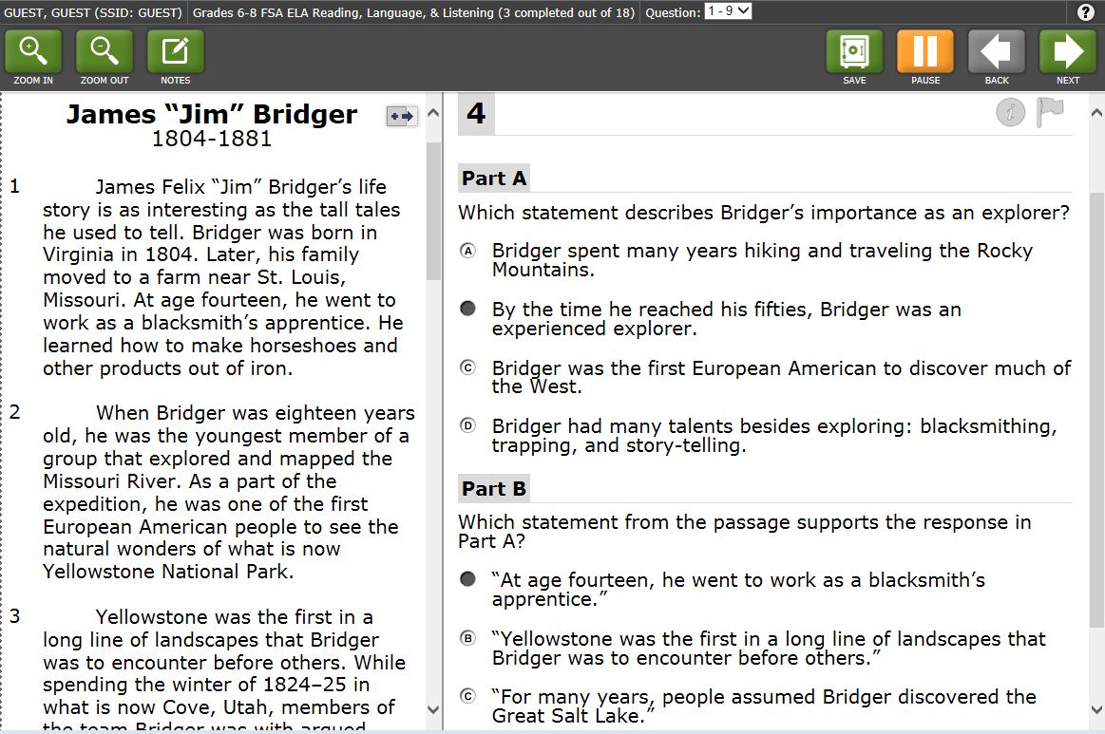
Two-Part Items
Notes:
Finally, some questions may have multiple parts, for example, Parts A and B. Both parts of the question (A and B) must be answered before moving to the next question OR the student may return to the item before submitting the test for scoring by hitting the “flag” button. At this point, no determination has been made on whether students can receive partial credit for getting only one question correct.

Slide 34
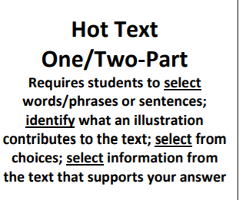
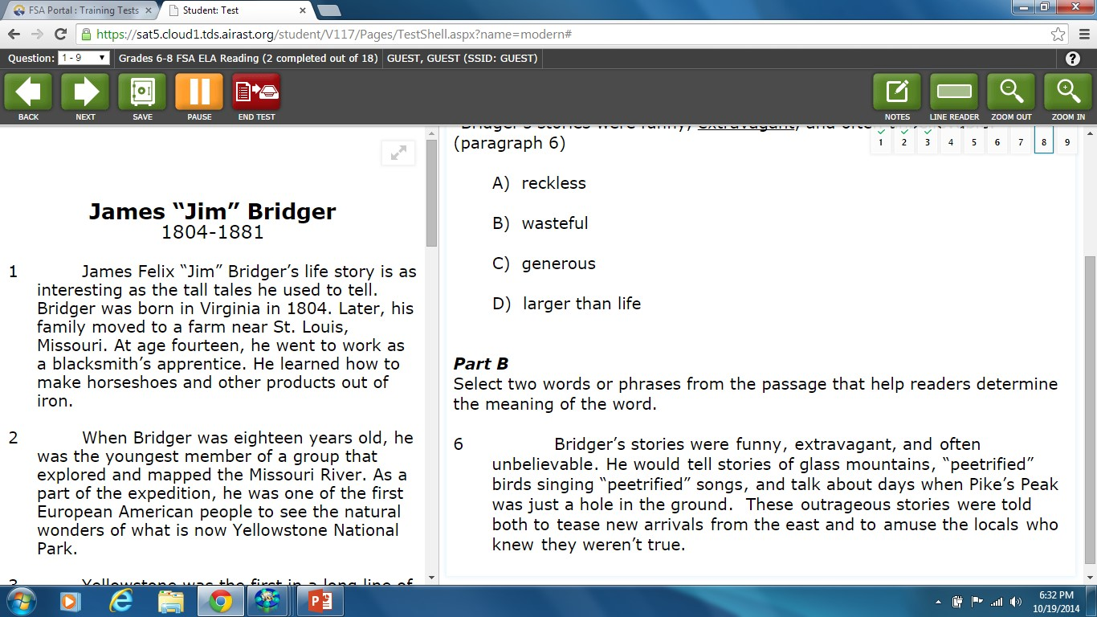
Hot Text Items
Notes:
Students are asked to highlight one or more words, phrases or sentences from selected amount of text that is provided. The example on the screen requires students to highlight two words or phrases that help the reader determine meaning of the word in Part A of the item.

Slide 35
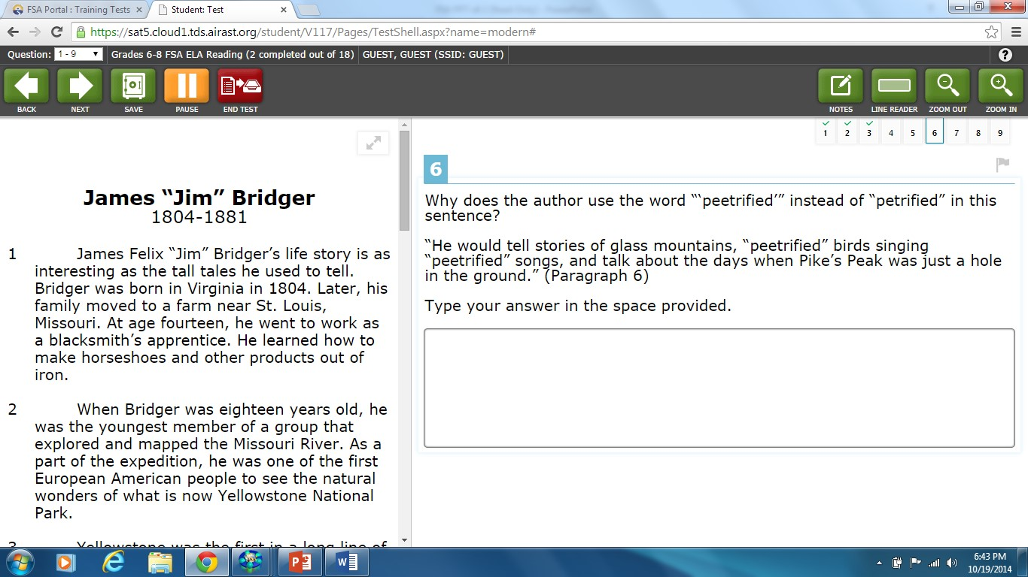
Open Response Item
Notes:
Open Response Item- Students are asked to read the provided text and respond to a question using no more than one paragraph to answer the question in its entirety. Use the keyboard to type the response into the provided text box. Students are not required to quote portions of the text to answer open response questions.

Slide 36
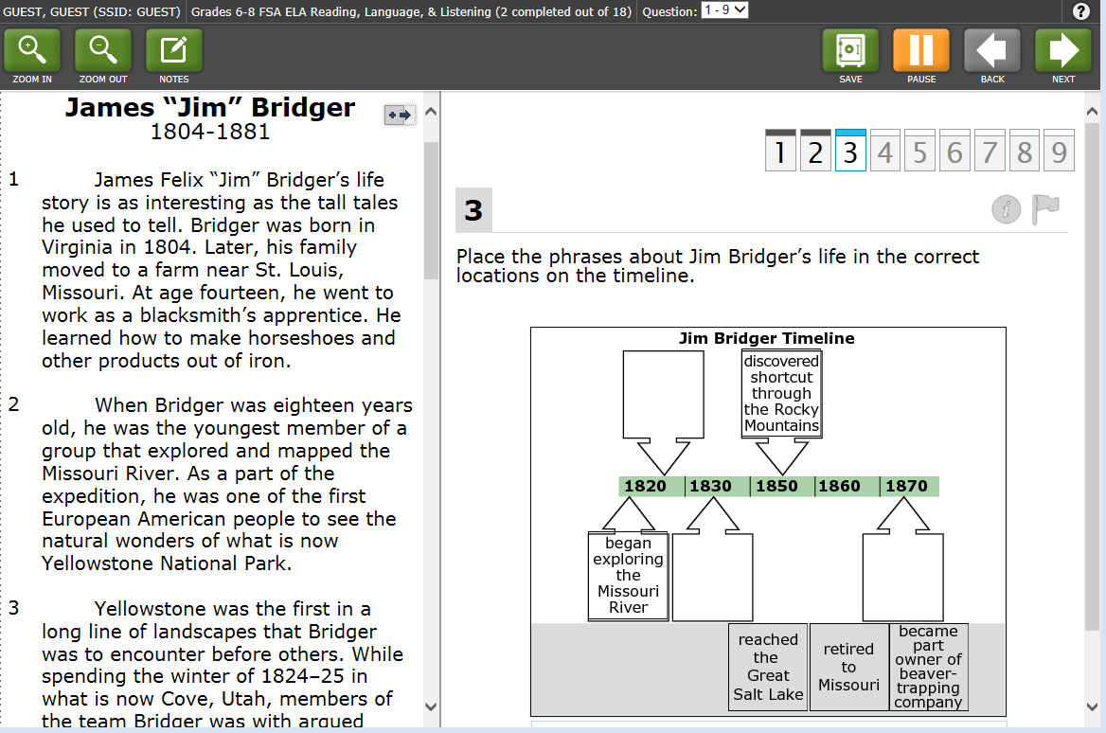
Graphic Response Item (GRID)
Notes:
Students are required to either click on a response option or drag a response option to another location for GRID items. The example on the screen requires students to drag the phrases provided at the bottom of the screen to the correct locations on the timeline.
Although 3rd grade will not be testing online this year, another example of a drag and drop item can be found on the 3rd grade ELA training test where students, after reading an informational piece of text about online learning, are asked to drag and drop pictures of the tools used for online learning into a box provided.

Slide 37
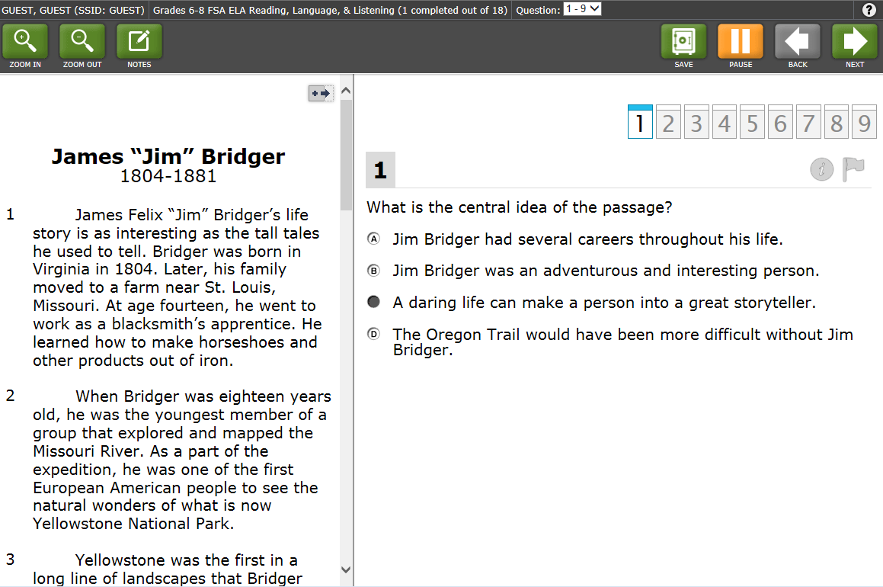
Text with a Series of Questions
Notes:
As students are asked to synthesize information within or between texts, a series of different types of questions may be asked on one text or a set of texts. The example on the slide is the first question asked about the text on James Bridger. It is a multiple-choice question.

Slide 38
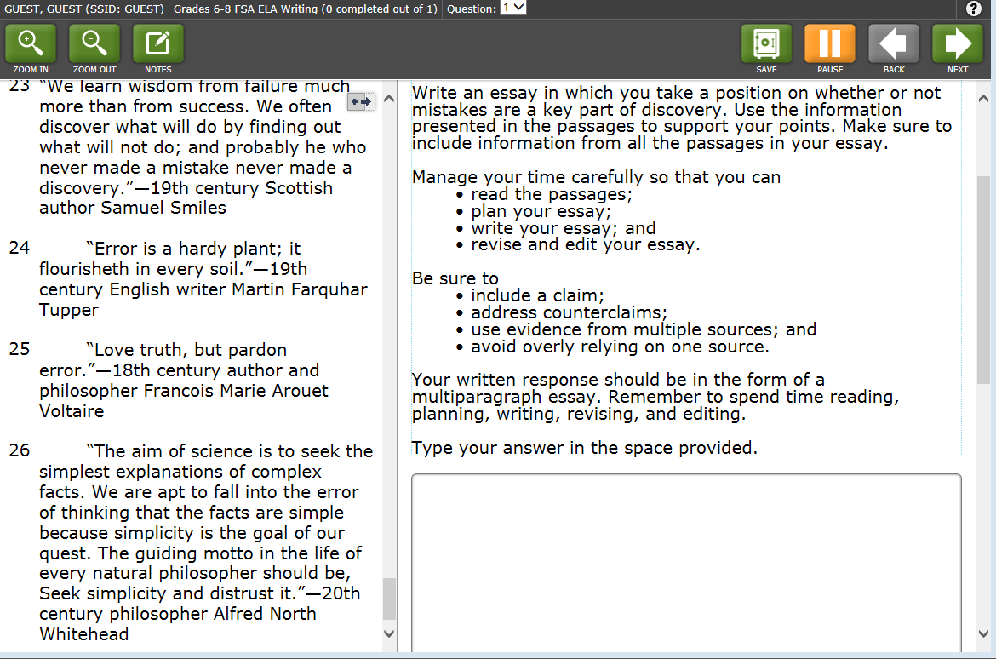
Text-based Writing
Notes:
This item requires the students to read the provided text and response to the essay prompt. The prompt is argumentative and requires the student to use information provided in the passages to support their position. This item is an example of how the reading and writing tasks are merged requiring students to read and comprehend the text, organize their thoughts to include all elements of an argumentative response (create a claim, use relevant evidence from multiple sources, and address counterclaims), and plan and write an essay using all phases of the writing process (planning, writing, and revision). Multiple standards are measured through this item. (“rich tasks” allow multiple standards to be measured)

Slide 39
Florida Standards Assessment Test Design Mathematical Practice Standards
Notes:
Students will read a stimulus about a single topic. A stimulus consists of several texts written on a single topic. The stimulus should consist of information or literary fiction or nonfiction from 2-4 texts and can cover a wide array of topics. After reading the stimulus, the students will respond to a writing prompt in which they will be required to synthesize provide information on a topic or take a stance to support an opinion or argument citing specific evidence from the texts to support their ideas.

Slide 40
FSA Math Reporting Categories
Sample from Grade 6
Ratio and Proportional Relationships
Students understand ratio concepts and use ratio reasoning to solve problems.
Expressions and Equations
Students apply and extend previous understandings of arithmetic to algebraic expressions. They reason about and solve one-variable equations and inequalities. They represent and analyze quantitative relationships between dependent and independent variables.
Math Reporting Categories vary by Grade Level: Login on the https://fsassessments.org/about-the-fsas.stml#fact-sheets

Slide 41
FSA Math Reporting Categories
Sample from Grade 6
Geometry
Students solve real-world and mathematical problems involving area, surface area, and volume.
Statistics and Probability Students develop understanding of statistical variability. They summarize and describe distributions.
The Number System
Students apply and extend previous understandings of multiplication and division to divide fractions by fractions. They compute fluently with multi-digit numbers and find common factors and multiples. They apply and extend previous understandings of numbers to the system of rational numbers
Math Reporting Categories vary by Grade Level: Login on the https://fsassessments.org/about-the-fsas.stml#fact-sheets

Slide 42
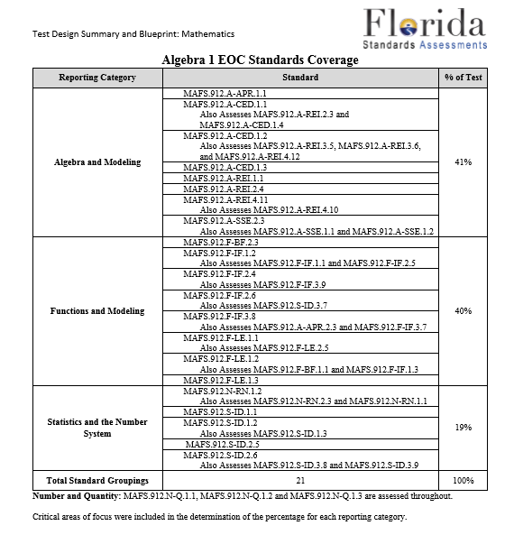
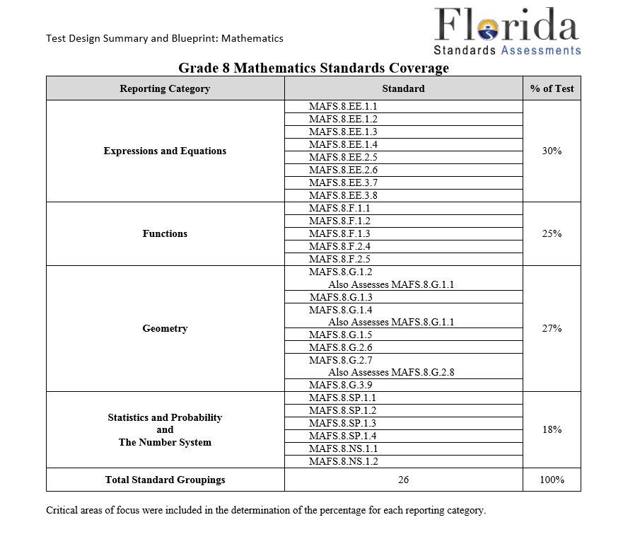
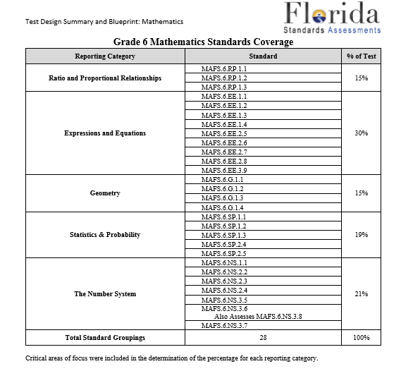
FSA Math Standards

Slide 43
Grades 6-8 Mathematics
Grade | Number of Items | Number of Sessions* | Number of Days | Administration Mode/Test Materials | TOTAL Testing Time
Grade 6 | 62 – 66 | 3 | 2 | CBT with work folder; no Calculator | 180 minutes
Grade 7 | 62 – 66 | 3 | 2 | CBT with work folder; Scientific Calculator (Sessions 2 and 3 only) | 180 minutes
Grade 8 | 62 – 66 | 3 | 2 | CBT with work folder; Scientific Calculator (Sessions 2 and 3 only) | 180 minutes
*FSA Math sessions are administered over two days.
For Grades 6-8, Session 1 is on Day 1, Sessions 2 & 3 on Day 2.

Slide 44
End-of-Course Assessments
Course | Number of Items | Number of Sessions | Number of Days | Administration Mode/Test Materials | TOTAL Testing Time
Algebra 1 | 64 – 68 | 2 | 2 | CBT with work folder; Scientific Calculator (Session 2 only) | 180 minutes
Geometry | 64 – 68 | 2 | 2 | CBT with work folder; Scientific Calculator (Session 2 only) | 180 minutes

Slide 45
Florida Standards Assessment Design Mathematics
Multiple Choice Items
Multi-select Items
Equation Response Items
Graphic Response Items
Notes:
The FSA Mathematics Design has some similar question designs to the ELA test. Multiple-Choice and Multi-Select mathematics items ask students to respond the same way as they would in ELA.
The mathematics item types are:
Multiple-Choice Response
Multi-Select Response
Open-ended Response – includes Equation Response and Multi-Step Response
Graphic Response – Drag and Drop, Hot Spot, Drawing and Graphing

Slide 46
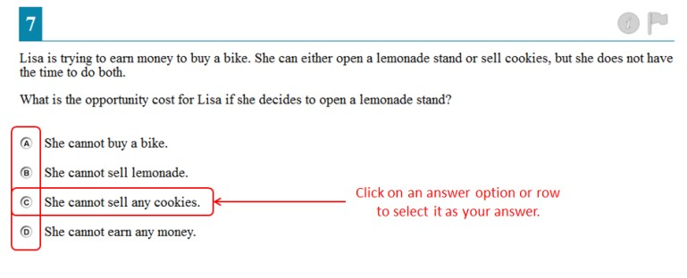
Multiple Choice Item
Notes:
Multiple-choice items requires students to select a single answer.

Slide 47
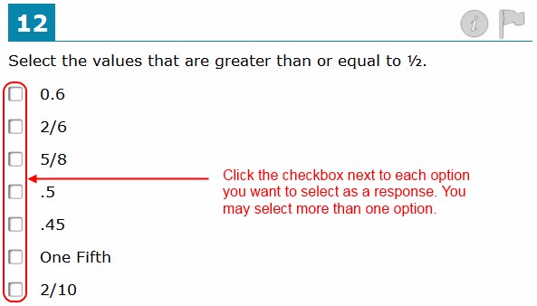
Multi-Select Items
Notes:
Multi-select items allow students to select more than one answer option. These are different from multi-choice items, which allow you to select only one response.

Slide 48
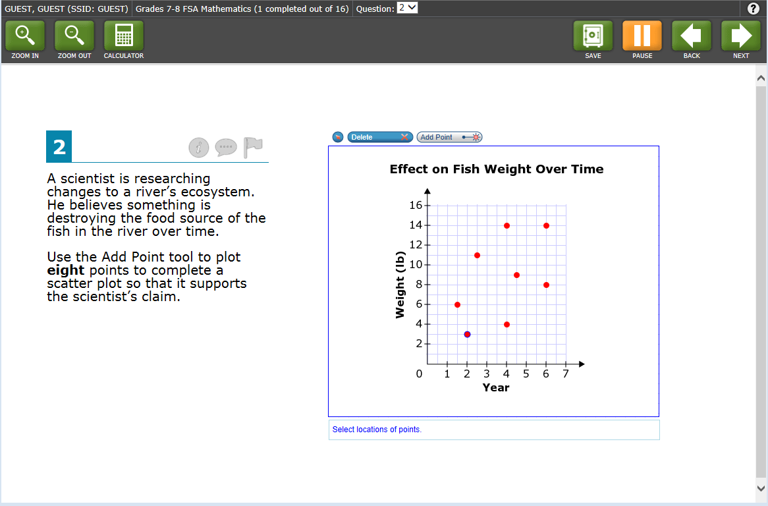
Graphic Response Item
Notes:
This type of graphic response question focuses on plotting information. Students are asked to read the item text and the information provided in the chart and then using the “Add Point” tool, plot eight points to correctly answer the question and complete a scatter plot that graphically depicts what is provided in the item text.

Slide 49
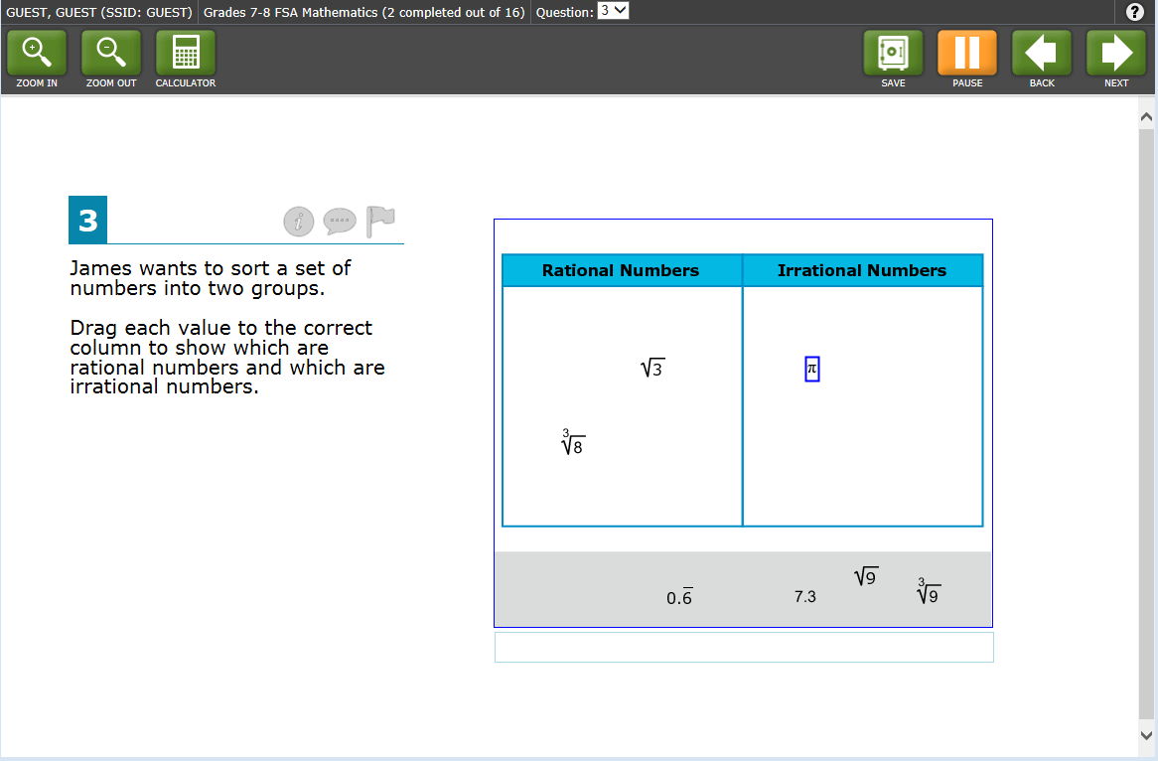
Graphic Response Item
Notes:
The graphic response item provided is an example of the “drag and drop” response where students are asked to sort rational and irrational numbers by dragging the different responses from the bottom of the page into the proper column. Another type of drag and drop item might require students to drag points from one location to another on a number line.

Slide 50
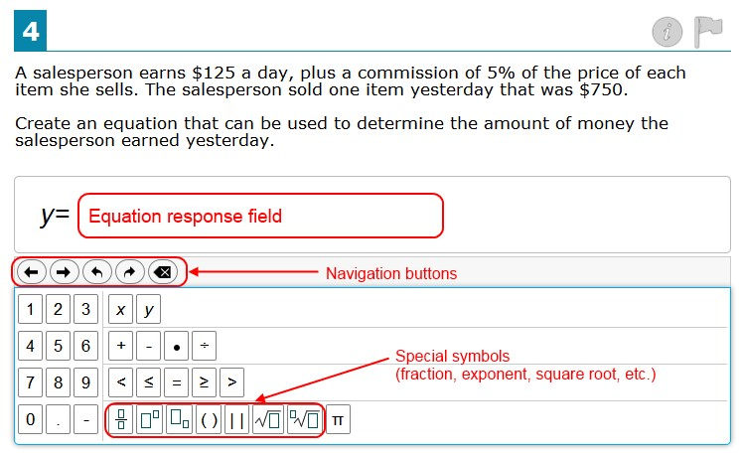
Equation Response Item
Notes:
Equation items are used extensively throughout the mathematics test. In this item you are required to enter a valid statement that answers the question. To enter an equation, students will click a button that is provided on the screen for each letter or symbol. An example of a more complex process of solving an equation from information provided on a diagram is illustrated in the next example.

Slide 51
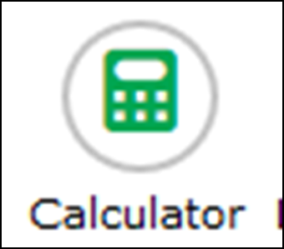
Computer-Based Tools
Formula
The Formula tool opens a pop-up window displaying the reference sheet for your test.
Be sure to scroll to the bottom of the reference sheet and use the horizontal scroll bar to see all of the information available.
Calculator
The Calculator tool will ONLY be available during Sessions 2 and 3 of the Grades 7 and 8 Mathematics test.
You can use the Calculator by tapping or clicking on the onscreen calculator or by using the appropriate keys on your keyboard.

Slide 52
FSA Calculator Policy
Assessment | Calculator Permitted
Grades 6 Mathematics | CBT – None CALCULATORS WILL NOT BE PERMITTED FOR ANY SESSION FOR GRADE 6
Grades 7 and 8 Algebra 1 Algebra 2 Geometry | Computer-based scientific calculator or hand-held scientific calculator (during certain sessions only)

Slide 53
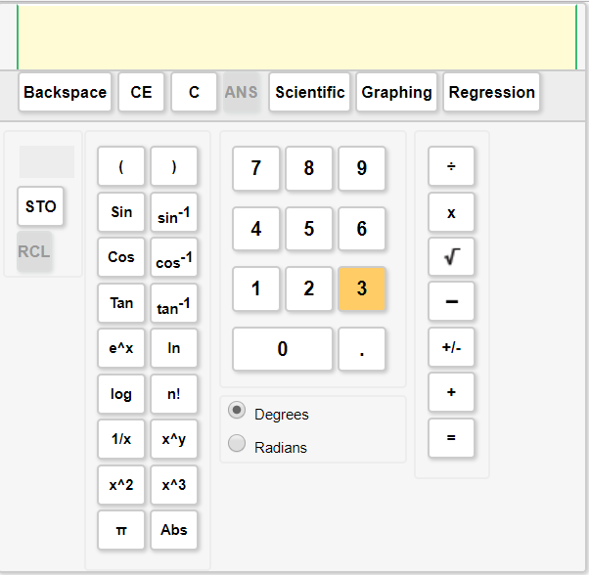
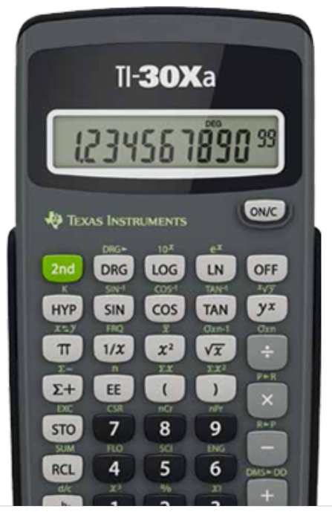
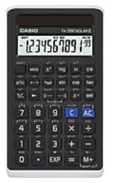
Handheld Scientific Calculators
The following are FDOE-approved calculators for the 2017–18 school year:
Texas Instruments TI-30Xa
Casio fx-260 solar
Casio fx-82 solar
Sharp EL-510R
Sharp EL-510RN
Online Calculator
https://tinyurl.com/q3s9xdm
Pinellas County Schools provides students with access to Handheld Scientific Calculators!

Slide 54
FSA Mathematics Reference Sheet
SAMPLE

Slide 55
Florida Standards Assessment Timeline & Dates
General Timeline Information will be provided during this presentation. Parents must reach out directed to schools for specific testing calendars. Testing schedule may vary!

Slide 56
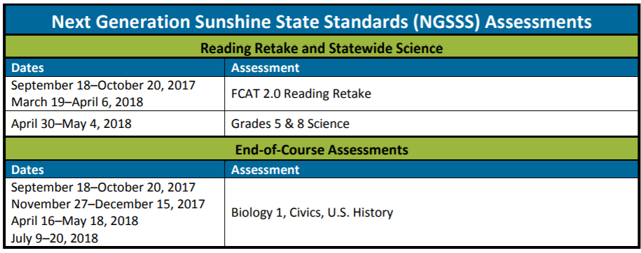
2017-2018 FSA Timeline
Please contact your child’s school to determine the specific testing dates!
Testing schedule may vary!

Slide 57
Participation of Students with Disabilities in Statewide Assessment
Federal legislation, including the Elementary and Secondary Education Act and the Individuals with Disabilities Education Act (IDEA), and Florida statutes require that students with disabilities participate in the statewide testing program and be afforded appropriate accommodations in instruction and assessment.
All determinations regarding participation in the statewide assessment program and need for classroom and testing accommodations must be documented in the student’s IEP or Section 504 plan.

Slide 58
Participation of Students with Disabilities in Statewide Assessment
Any student with a disability is expected to participate in the statewide assessment program with or without accommodations unless the student meets criteria for participation in the FAA.
The IEP team makes the decision to have a student with a significant cognitive disability take the FAA based on the guidelines in Rule 6A-1.0943(4), Florida Administrative Code (F.A.C.).

Slide 59
FSA Portal

Slide 60
https://fsassessments.org/students-and-families/practice-tests/index.stml

Slide 61
Informational Resources
Florida Department of Education
http://www.fldoe.org/
CPALMS
http://www.cpalms.org/Public/
FLDOE Assessment Website
http://www.fldoe.org/accountability/assessments/index.stml
FSA Portal
https://fsassessments.org/
Notes:
The informational resources listed are referenced throughout the PowerPoint.
There is an informational FSA Technology Moodle for teachers and administrators that can be accessed at the website provided on the slide.
CPALMS is an online toolbox of information, vetted resources, and interactive tools that helps educators effectively implement teaching standards. It is the State of Florida’s official source for standards information and course descriptions.
FLDOE Assessment Website is the official Florida Department of Education assessment website
FSA Portal is the website that provides access to resources that support all stakeholders in better understanding the expectations of the Florida Standards Assessment
Florida STEM Wikispaces is the Florida Department of Education Mathematics, Science, and STEM Wikispace. FSA guidance tools can be found under the Podcasts, Vodcasts, Online Meeting Archives and Note tab on the right side of the webpage screen.

Slide 62
Tools to Help Students Prepare

Slide 63
Before the FSA…
The night before the FSA:
Make sure your child gets enough sleep.
The morning of the FSA:
Eat a normal breakfast.
Talk your child.
Arrive at school early.

Slide 64
Pinellas County Schools Department of Middle School Education How to access Middle School Information?

Slide 65
Dywayne B. Hinds, Ed.D.
Executive Director Middle School Education
301 Fourth Street SW, P.O. Box 2942, Largo, FL 33779-2942
Ph. (727) 588-6453
Fax (727) 588-6516
Hindsdy@pcsb.org

